Slide 1

MySQL Administration Script
A Python-based CLI tool for managing MySQL databases, tables, and users.
Presented by:
Ziyad Tarek
Mohamed Mahmoud
Mohamed Zalat

Slide 2
Project Overview
Description
Key Highlights
The MySQL Administration Script is a Python-based command-line tool designed to simplify MySQL database management. It provides features for database, table, and user management, along with performance monitoring.
Easy-to-use CLI interface. Supports bulk operations, flexible queries, and user permissions. Robust error handling and retry logic.

Slide 3




Key Features
Database Management
Table Management
Data Management
User Permissions
Connect, list databases, switch databases.
Create, delete, describe tables, show relationships.
Insert, update, delete, search data, bulk insert from CSV.
Create, delete users, grant/revoke privileges.
Performance & Logs
Show slow queries, display database storage size.

Slide 4
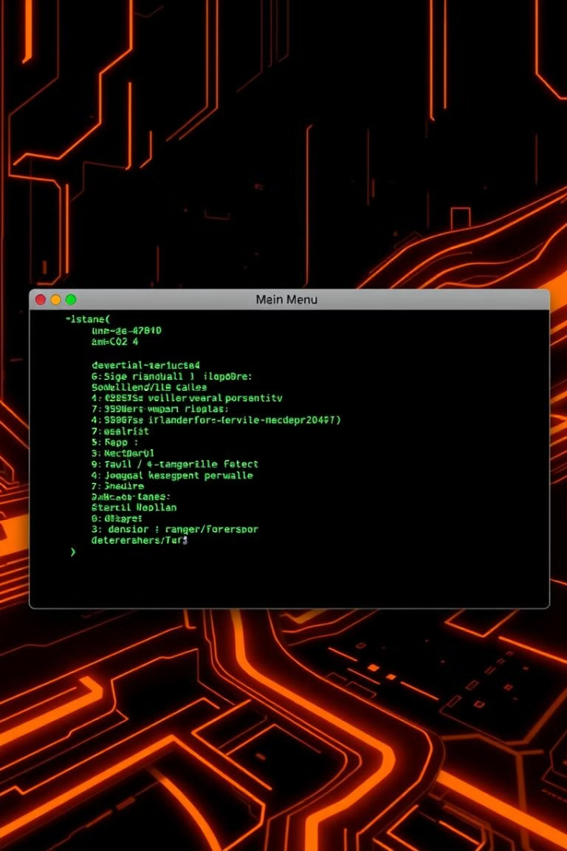
Get Started
Clone the Repository
git clone https://github.com/ziyad-tarek1/MySQL_Administration_Script.git
Run the Script
python mysql_admin_script.py
Follow the Prompts
Follow the prompts to manage your MySQL databases.
Start managing your MySQL databases with ease today!

Slide 5

Code Snippet - Connecting to MySQL
import mysql.connector
def connect_to_mysql():
host = input("Enter MySQL host (default: localhost): ") or "localhost"
user = input("Enter MySQL username: ")
password = input("Enter MySQL password: ")
try:
conn = mysql.connector.connect(host=host, user=user, password=password)
print("Connected to MySQL server successfully!")
return conn
except mysql.connector.Error as err:
print(f"Error: {err}")
return None
This function establishes a connection to a MySQL server using user-provided credentials. It handles errors gracefully and ensures the script doesn't crash on invalid inputs.

Slide 6
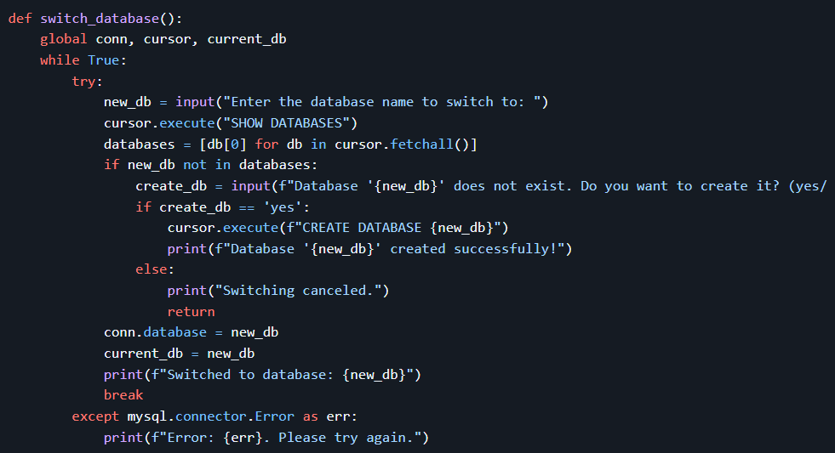
Code Snippet - Switch Database
Description:
Switches to a specified database. If the database does not exist, it prompts the user to create it.

Slide 7
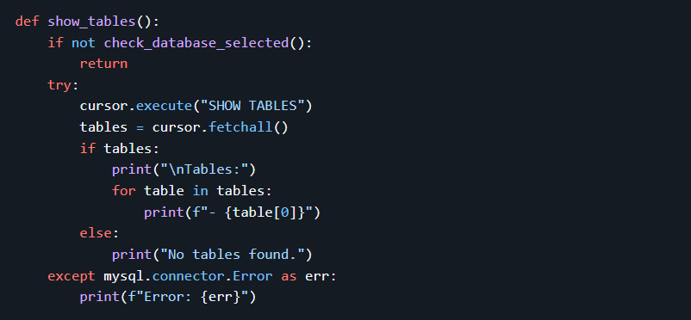
Code Snippet - Show Tables
Description:
Lists all tables in the currently selected database.

Slide 8
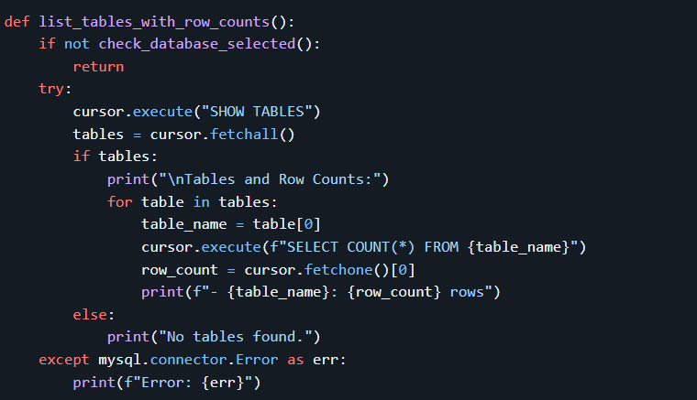
Code Snippet - List Tables with Row Counts
Description:
Lists all tables in the current database along with the number of rows in each table.

Slide 9
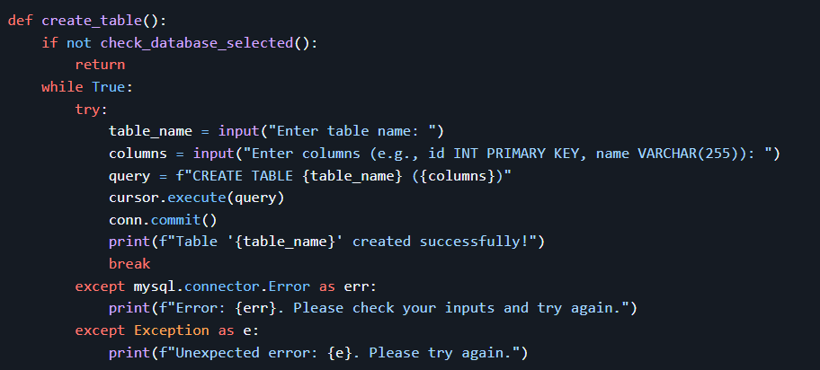
Code Snippet - Create a Table
Description:
Creates a new table in the current database.

Slide 10
Code Snippet - Delete a Table
Description:
Deletes a table from the current database.

Slide 11
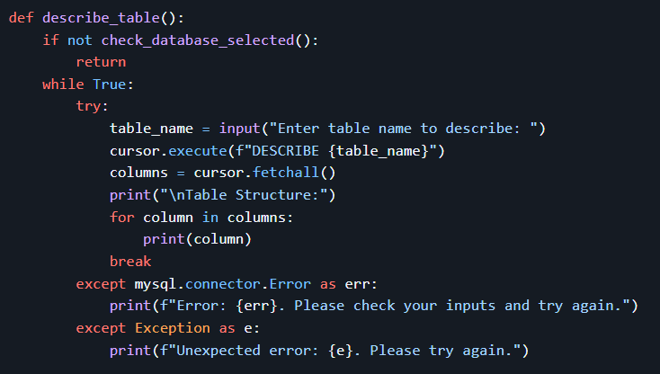
Code Snippet - Describe a Table
Description:
Displays the structure of a table.

Slide 12
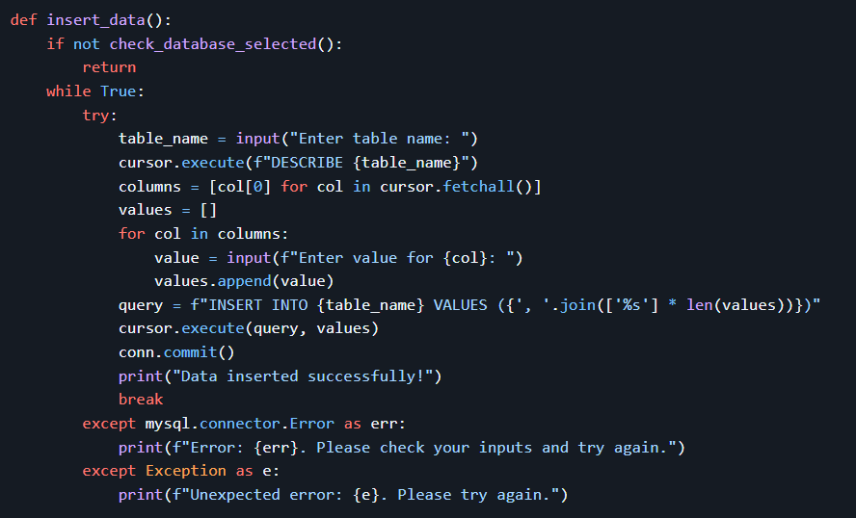
Code Snippet - Insert Data into a Table
Description:
Inserts a new row into a table.

Slide 13
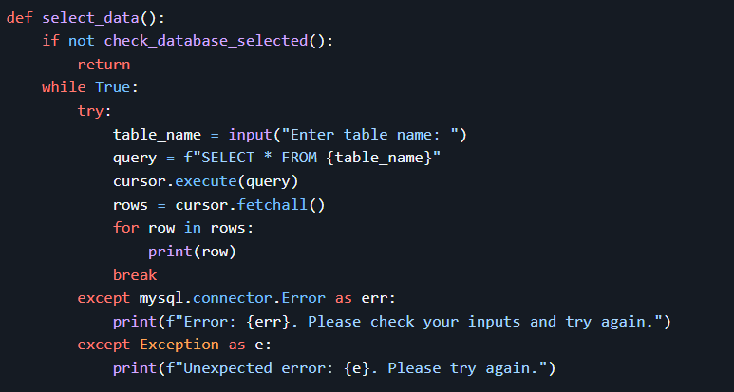
Code Snippet - Select Data from a Table
Description:
Retrieves and displays all rows from a table.

Slide 14
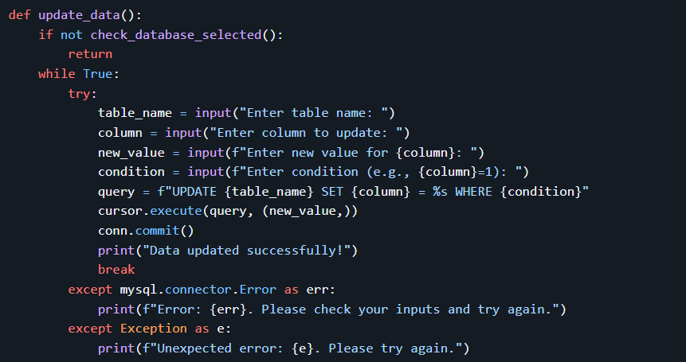
Code Snippet - Update Data in a Table
Description:
Updates a row in a table based on a condition.

Slide 15
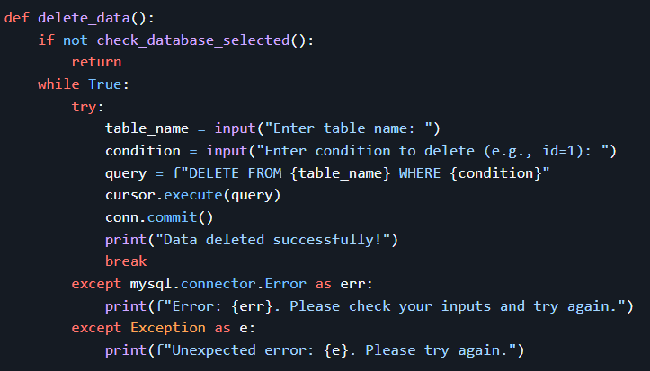
Code Snippet - Delete Data from a Table
Description:
Deletes rows from a table based on a condition.

Slide 16
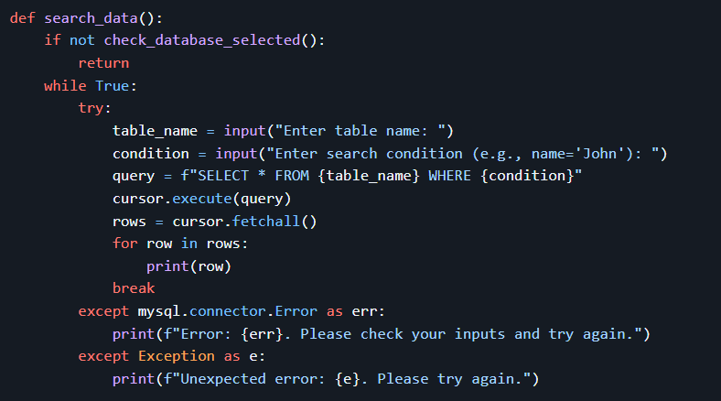
Code Snippet - Search Data in a Table
Description:
Searches for rows in a table based on a condition.

Slide 17
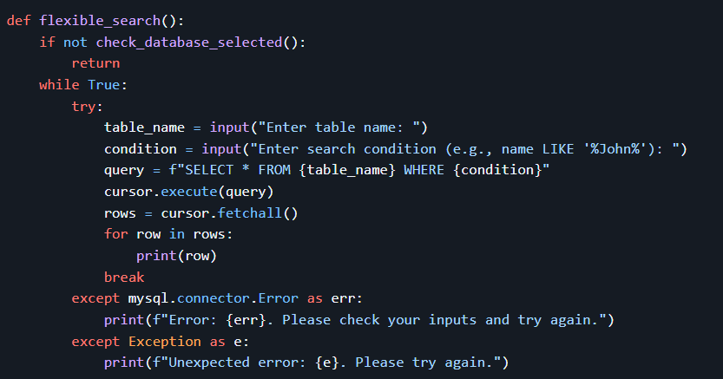
Code Snippet - Flexible Search Queries
Description:
Allows for more complex search queries using SQL-like conditions.

Slide 18
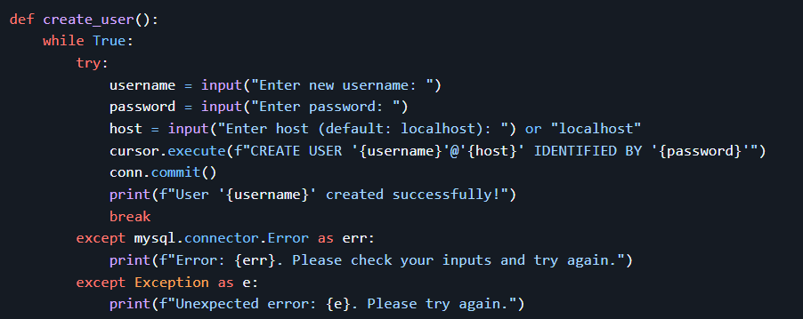
Code Snippet - Create MySQL User
Description:
Creates a new MySQL user.

Slide 19
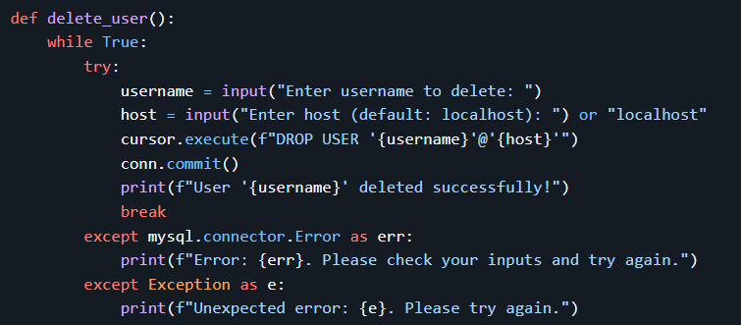
Code Snippet - Delete MySQL User
Description:
Deletes an existing MySQL user.

Slide 20
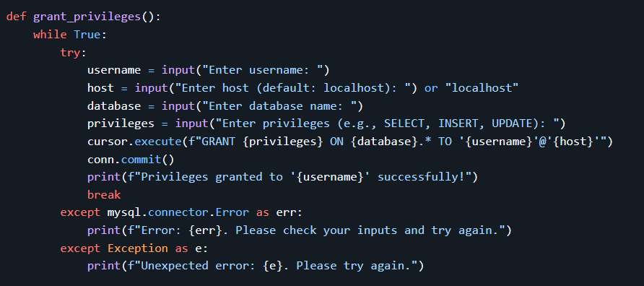
Code Snippet - Grant Privileges
Description:
Grants privileges to a MySQL user on a specific database.

Slide 21
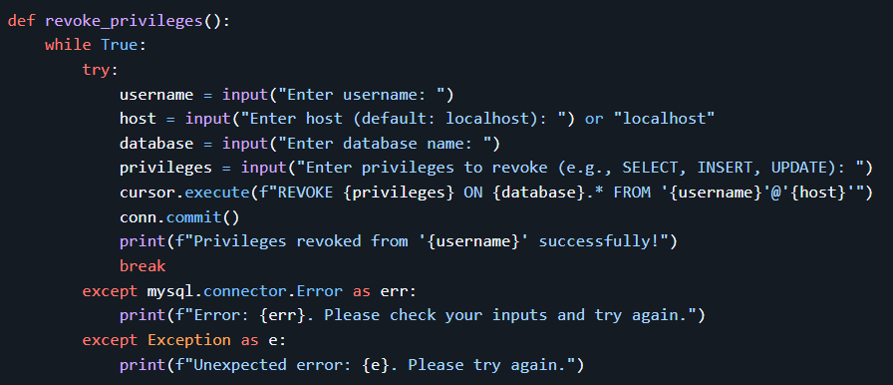
Code Snippet - Revoke Privileges
Description:
Revokes privileges from a MySQL user on a specific database.

Slide 22
Summary of All mysql.connector Functions and Methods
Function/Method | Description
mysql.connector.connect() | Establishes a connection to the MySQL server.
conn.database | Sets or switches the current database.
conn.commit() | Commits the current transaction (saves changes to the database).
conn.close() | Closes the connection to the MySQL server.
conn.cursor() | Creates a cursor object for executing SQL queries.
cursor.execute() | Executes a SQL query.
cursor.fetchall() | Fetches all rows from the result of a query.
cursor.fetchone() | Fetches a single row from the result of a query.
cursor.close() | Closes the cursor object.
mysql.connector.Error | Catches MySQL-specific errors.

Slide 23
Summary of All Queries
Functionality | Query
List Databases | SHOW DATABASES;
Create Database | CREATE DATABASE db_name;
List Tables | SHOW TABLES;
Count Rows in Table | SELECT COUNT(*) FROM table_name;
Create Table | CREATE TABLE table_name (column_definitions);
Delete Table | DROP TABLE table_name;
Describe Table | DESCRIBE table_name;
Insert Data | INSERT INTO table_name VALUES (value1, value2, ...);
Select Data | SELECT * FROM table_name;
Update Data | UPDATE table_name SET column_name = new_value WHERE condition;
Delete Data | DELETE FROM table_name WHERE condition;
Search Data | SELECT * FROM table_name WHERE condition;
Flexible Search | SELECT * FROM table_name WHERE condition;
Create MySQL User | CREATE USER 'username'@'host' IDENTIFIED BY 'password';
Delete MySQL User | DROP USER 'username'@'host';
Grant Privileges | GRANT privileges ON database_name.* TO 'username'@'host';
Revoke Privileges | REVOKE privileges ON database_name.* FROM 'username'@'host';

Slide 24
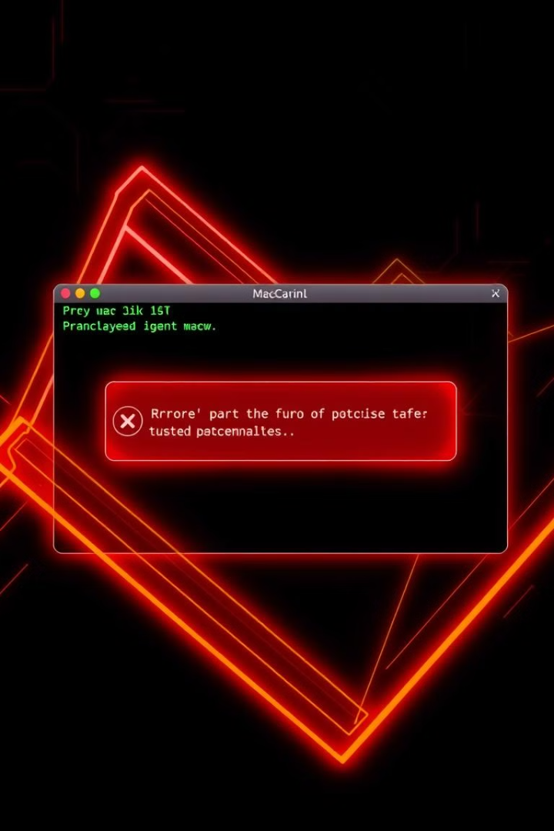
Error Handling

Slide 25

1
MySQL Connection Errors
Function: connect_to_mysql()
Handled Errors:
Invalid credentials (host, username, password).
Network/connection failures.
Strategy:
Retries indefinitely until a successful connection.
Uses mysql.connector.Error to catch MySQL-specific errors.
Provides clear feedback: "Error: {err}. Please check your credentials and try again."

Slide 26
2
Database Operations
a. Switching Databases (switch_database())
Handled Errors:
Non-existent databases.
Invalid SQL syntax during database creation.
Strategy:
Checks if the database exists using SHOW DATABASES.
Prompts the user to create the database if missing.
Catches mysql.connector.Error for MySQL issues (e.g., invalid name).
b. Database Selection Validation (check_database_selected())
Handled Errors:
No database selected before table/data operations.
Strategy:
Forces the user to select a database before proceeding.
Returns False to block further execution until resolved.

Slide 27
3. Table Operations
3
a. Creating Tables (create_table())
Handled Errors:
Invalid column definitions.
Duplicate table names.
Syntax errors in CREATE TABLE queries.
Strategy:
Uses mysql.connector.Error to catch MySQL errors.
Generic Exception as a fallback for unexpected issues.
b. Deleting Tables (delete_table())
Handled Errors:
Non-existent tables.
Invalid table names.
Strategy:
Catches mysql.connector.Error and provides actionable feedback.

Slide 28
4
Data Manipulation
a. Inserting Data (insert_data())
Handled Errors:
Column count/value mismatches.
Invalid data types (e.g., inserting a string into an INT column).
Strategy:
Uses DESCRIBE to validate column existence before insertion.
Parameterized queries (%s placeholders) to avoid syntax errors.
b. Updating/Deleting Data (update_data(), delete_data())
Handled Errors:
Invalid column names.
Syntax errors in WHERE conditions.
Non-existent rows matching the condition.
Strategy:
Catches mysql.connector.Error for MySQL issues.

Slide 29
Robust Error Handling
1
Error Handling
The script handles errors such as invalid user inputs, missing databases or tables, and failed queries.
2
Example
If a user enters an invalid table name, the script displays a helpful error message and ask the user if you want to create one.

Slide 30
Thank You
Thank you for your interest in the MySQL Administration Script!
GitHub repository: https://github.com/ziyad-tarek1/MySQL_Administration_Script
Contact:
ziyadtarek180@gmail.com
mohamedmahmoud6498@gmail.com
mohmed.galal.zalat.mz@gmail.com

Slide 31

Questions?
Feel free to ask any questions you may have.

